Slide 1


DISTRIBUTED COMPUTING
Sunita Mahajan, Principal, Institute of Computer Science, MET League of Colleges, Mumbai
Seema Shah, Principal, Vidyalankar Institute of Technology, Mumbai University

Slide 2
Chapter - 3
Interprocess Communication

Slide 3
Topics
Message Passing
Case Study: IPC in MACH
Group communication
Case Study: CBCAST protocol in ISIS

Slide 4
Message Passing

Slide 5
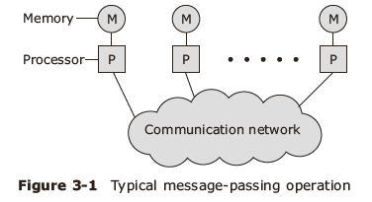
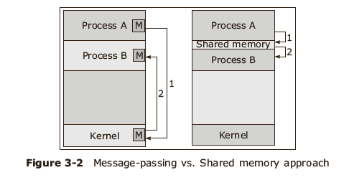
Message Passing vs Shared Memory

Slide 6
Desirable Features of Message Passing Systems
Hardware approach
Functionality
Performance
Uniform semantics
Efficiency
Reliability
Correctness
Flexibility
Portability
Security

Slide 7
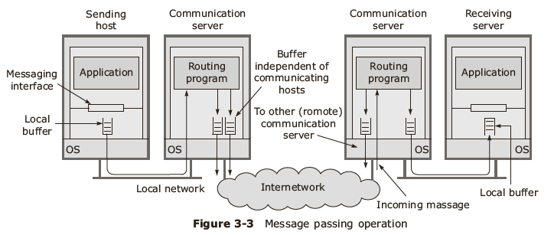
Message passing process

Slide 8
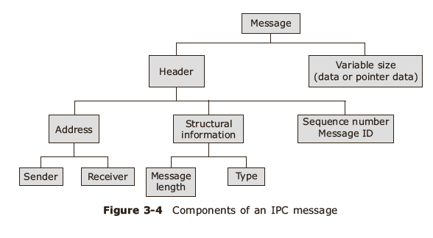
IPC message format

Slide 9
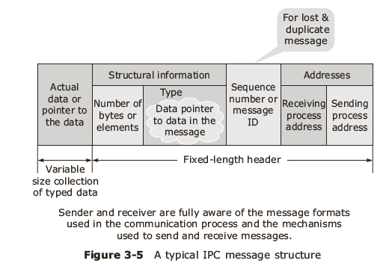
IPC Message

Slide 10
IPC synchronization
Ensure message is received in the buffer:
  Polling
  Interrupt
Message communication techniques
  Synchronous communication
  Asynchronous communication

Slide 11
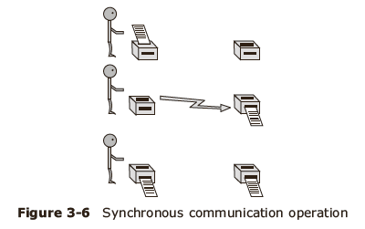
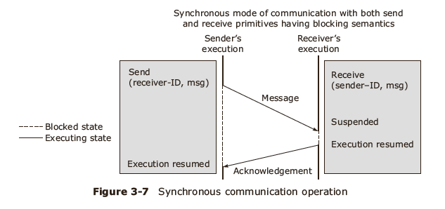
IPC: Synchronous communication

Slide 12
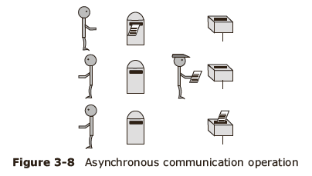
IPC: Asynchronous communication

Slide 13
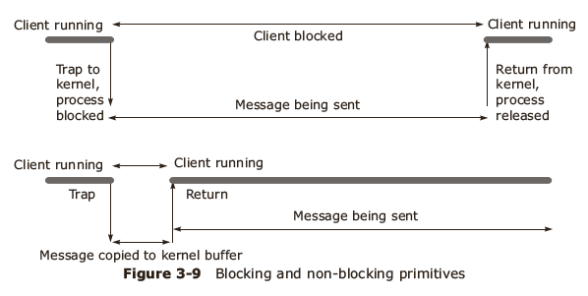
IPC primitives

Slide 14
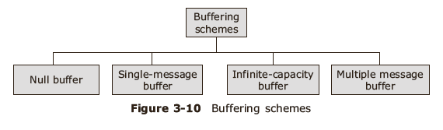
Message buffering strategies

Slide 15
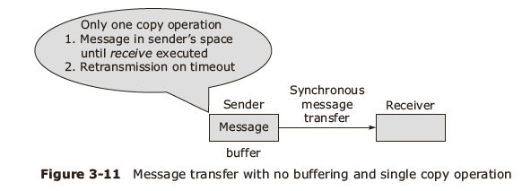
Null buffering

Slide 16
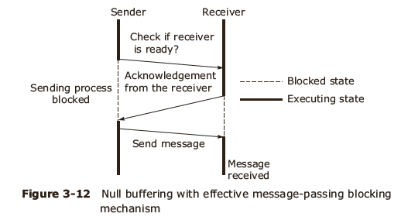
Null buffering with blocked receiver

Slide 17
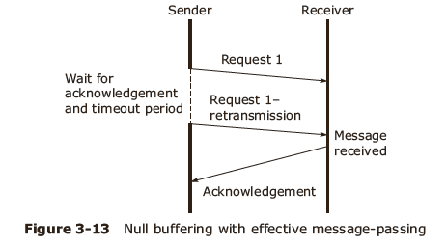
Null buffering with non blocked receiver

Slide 18
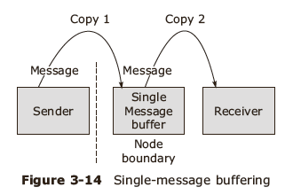
Message buffering: single buffer

Slide 19
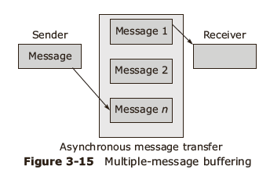
Message buffering: multiple message buffer
Receiver overflow handled using:
  Unsuccessful communication indication
  Flow control mechanism

Slide 20
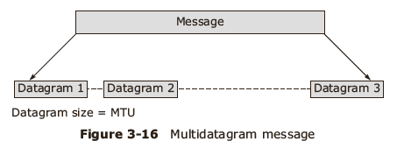
Multidatagram messaging
Concept of MTU
Message sequencing and reassembly
Message contents
Message representation: tagged, untagged

Slide 21
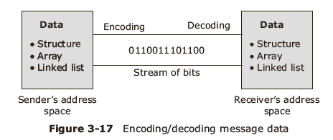
Message data transmission

Slide 22
Process addressing techniques
Explicit addressing :send (process_id, message) and receive (process_id, message)
Implicit addressing:send_any (service_id, message) and receive_any (service_id, message)
  Two level addressing : machine_id@local_id (receiver machine name)
  Three level addressing: machine_id@local_id@machine_id. (Node where the process was created @ generated by the first machine@ last known location of the machine)

Slide 23
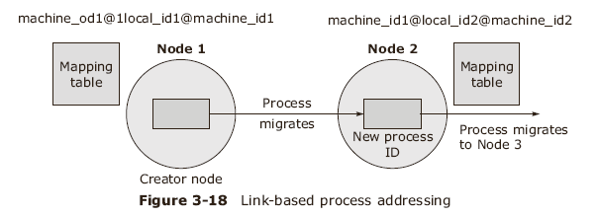
Link-based Process Addressing

Slide 24
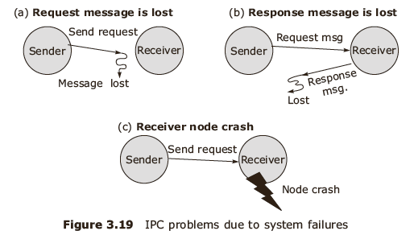
Failure handling mechanism
IPC problems due to system failures

Slide 25
IPC Protocols
4-message reliable IPC protocol
3-message reliable IPC protocol
2-message reliable IPC protocol

Slide 26
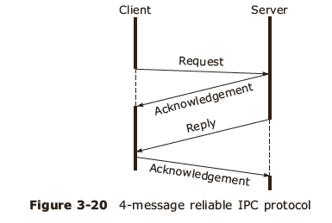
IPC 4 message protocol

Slide 27
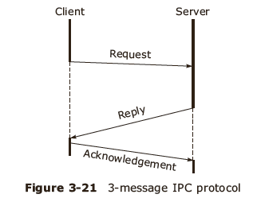
IPC 3 message protocol

Slide 28
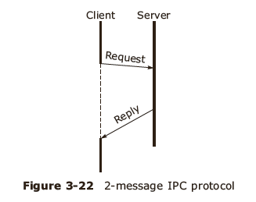
IPC 2 message protocol

Slide 29
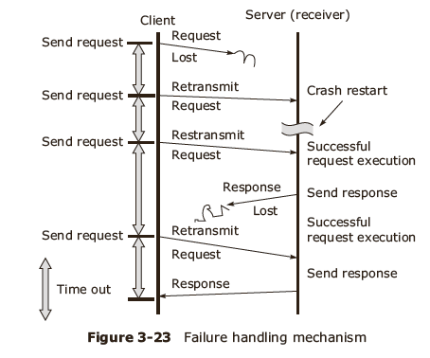
IPC Failure

Slide 30
Case Study: IPC in MACH

Slide 31
Case Study: IPC in MACH
MACH IPC Components
  Ports
  Messages
Message format
NetMsgServer

Slide 32
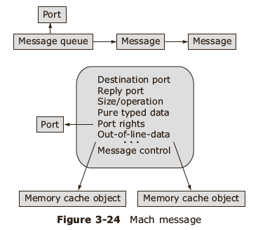
MACH message format

Slide 33
Group communication

Slide 34
Group Communication
Unicast –one to one communication
Many-to-one group communication
One-to-many or multicast group communication

Slide 35
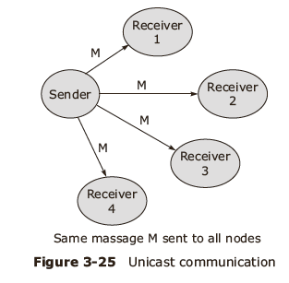
Unicast group communication

Slide 36
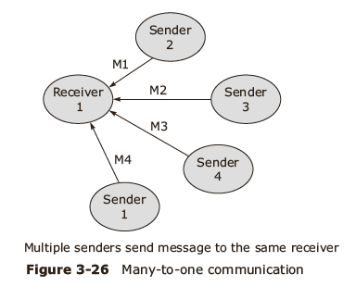
Many to one communication

Slide 37
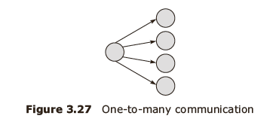
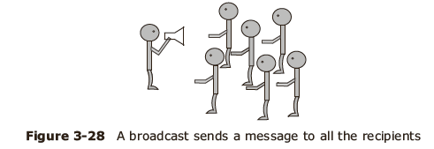
Broadcast communication
Multi cast communication

Slide 38
Types of Groups
Closed group
Open group
Peer group
Hierarchical group

Slide 39
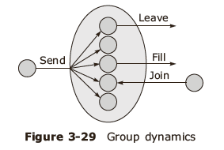
Group management
Centralized approach
Distributed approach

Slide 40
Group addressing Message delivery
High level naming
For large LANs/ MANs: send message to individual group members
Send to all semantics
Bulletin board semantics

Slide 41
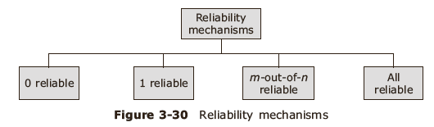
Reliability mechanism
Classified based on number of receivers from which sender expects a response

Slide 42
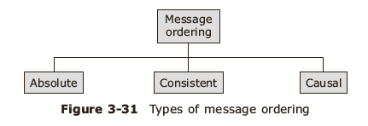
Message ordering

Slide 43
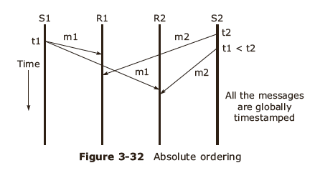
Message ordering: Absolute Ordering

Slide 44
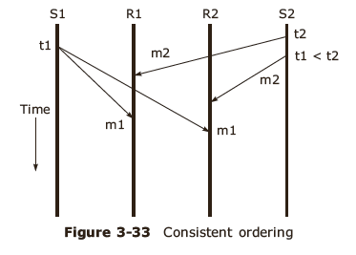
Message ordering: Consistent ordering

Slide 45
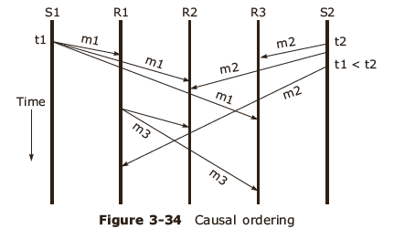
Message ordering: Causal ordering

Slide 46
Case Study: CBCAST protocol in ISIS

Slide 47
CBCAST protocol
S: vector of the sending process attached to the message
R : vector of the receiving process
i: sequence number of the sender process
Runtime system tests following conditions
  S[i] = R [i] + 1
  S[j] <= R[j] for j <> i

Slide 48
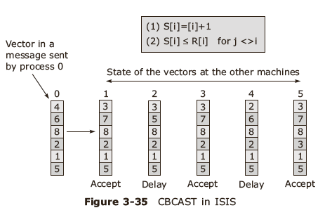
CBCAST protocol in ISIS

Slide 49
Summary
Message Passing
Case Study: IPC in MACH
Group communication
Case Study: CBCAST protocol in ISIS

